Slide 1
RENTAL AND HOUSING ANALYSIS

Slide 2
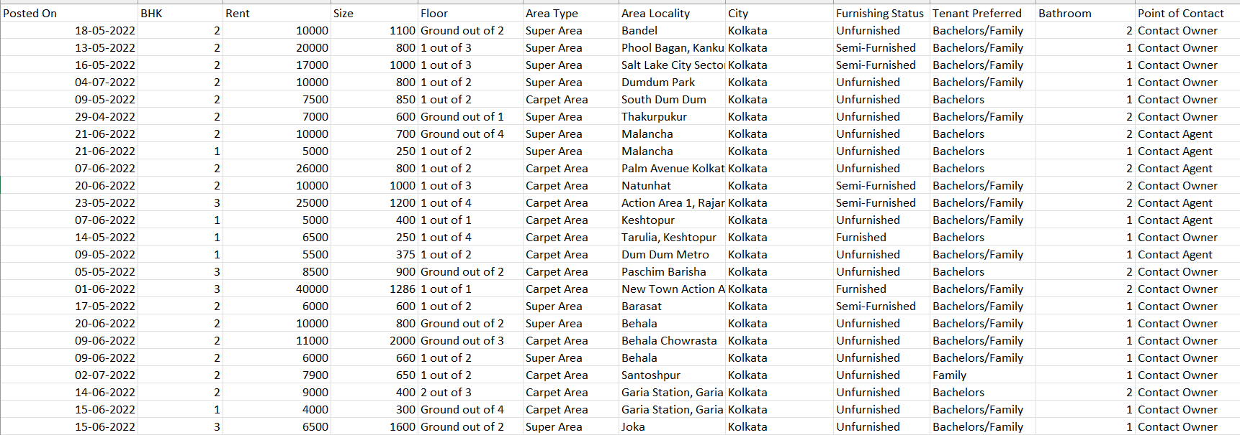
IMPORT DATA
First, we import the data related to the topic rental and housing analysis.
House_rent_dataset

Slide 3
ANALYSING WITHOUT USING PIVOT TABLE

Slide 4
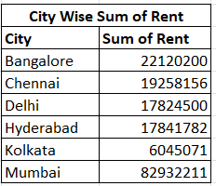
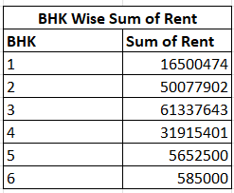
Using sumif
=SUMIF (range, criteria, [sum_range])
City Wise Sum Of Rent
=SUMIF(H2:H4747,O4,C2:C4747)
BHK Wise Sum Of Rent
=SUMIF(B2:B4747,R4,C2:C4747)

Slide 5
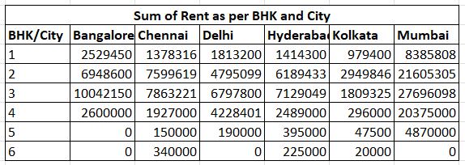
Using sumifs
=SUMIFS(C2:C15,B2:B15,D3,A2:A15,D4)
Sum Of Rent As Per BHK And City
=SUMIFS($C$2:$C$4747,$B$2:$B$4747,$U4,$H$2:$H$4747,V$3)

Slide 6
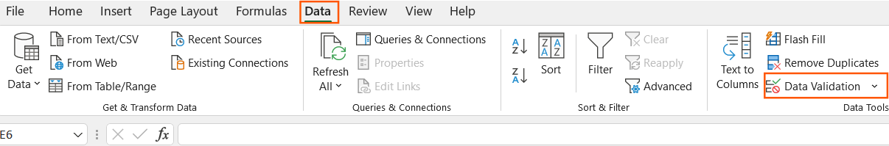
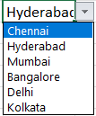



Data validation
Select Data → Data Validation →
From the dialog box select list and select column range for source.
Click Ok.

Slide 7
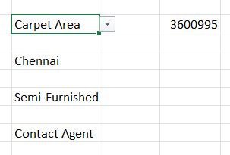
Sumifs
=SUMIFS(C2:C4747,F2:F4747,S12,H2:H4747,S14,I2:I4747,S16,L2:L4747,S18)
Using all the criteria and find the sum of rent.
Here, we also change the criteria using the drop-down

Slide 8
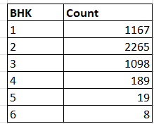
countif
Used to count the number of cell that meet the criteria.
=COUNTIF(range,criteria)
=COUNTIF($B$2:$B$4747,$Q16)

Slide 9
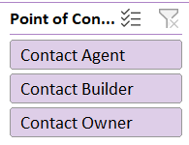
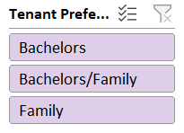
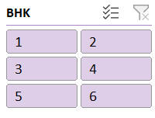
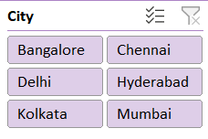
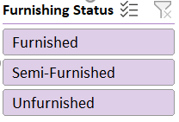
Slicer
Change the data into table.
Home → Format As Table → select the Table.
Next, we’ve to create a slicer.
Click on the Table → Table Design → Insert Slicer

Slide 10
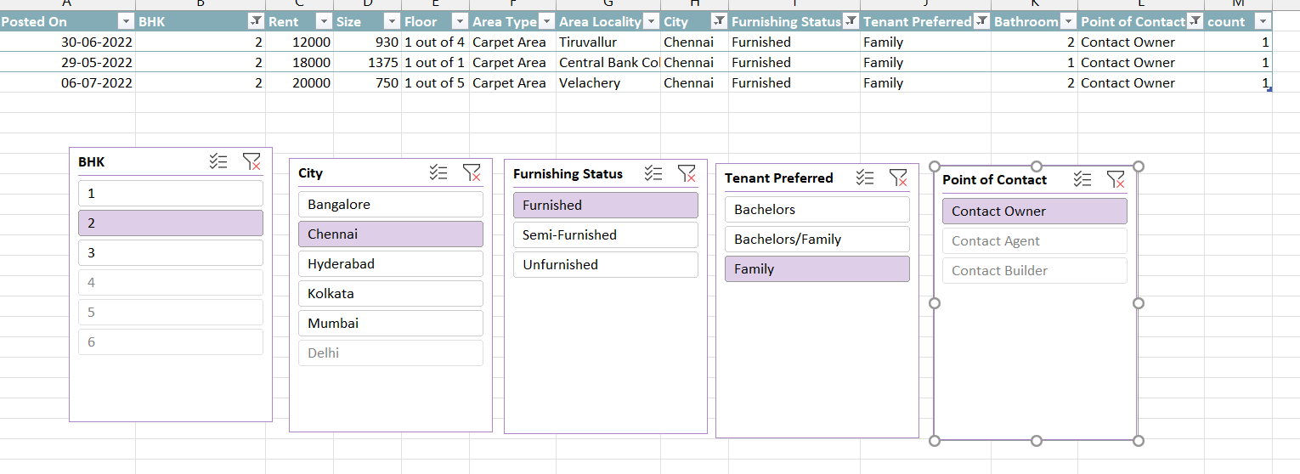
We can analyse using slicer in the table.

Slide 11
ANALYSING USING PIVOT TABLE

Slide 12
TABLE AND SORTING
First add the column count value of 1.
Change the data into table.
Home → Format As Table → Select The Table.
Next, sort the data from newest to oldest.
Home → Filter →
Click The Drop Down Arrow → Sort Newest To Oldest.

Slide 13
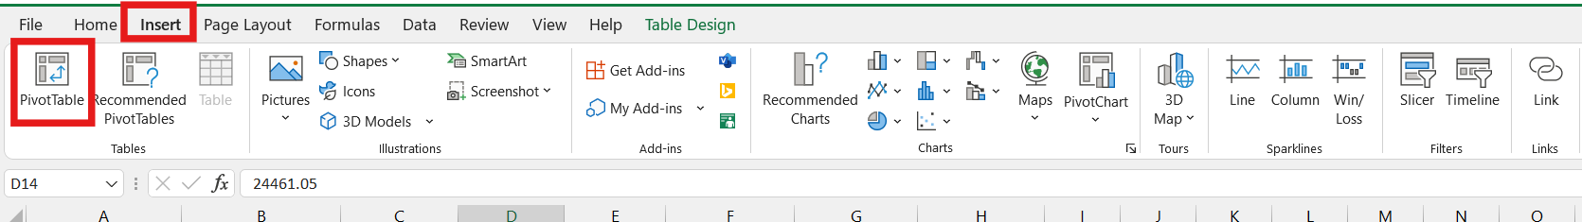
PIVOT TABLE
Next, we create a pivot table.
Click on any one cell in the table.
Go To Insert → Click Pivot Table
Click On The Pivot Table → Pivot Table Analyze → Field List

Slide 14
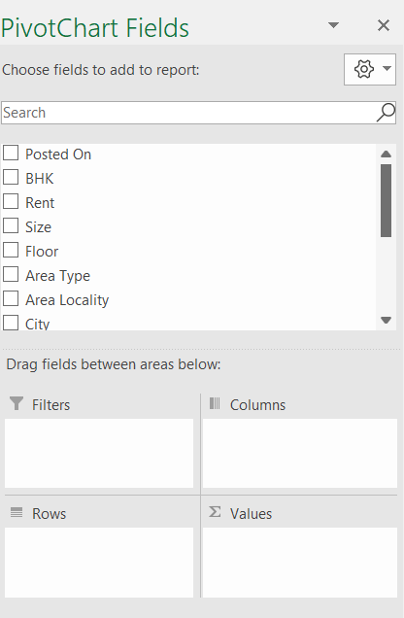
Pivot chart fields
Then drag fields between the given areas.
Filters
Columns
Rows
Values

Slide 15
Pivot charts
Next, we create charts for the pivot table.
Click On The Pivot Table → Pivot Table Analyze → Pivot Chart → Click On The Chart For Analysis.

Slide 16
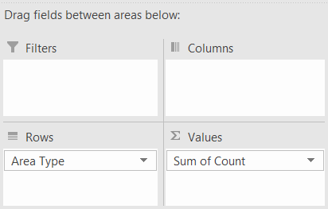
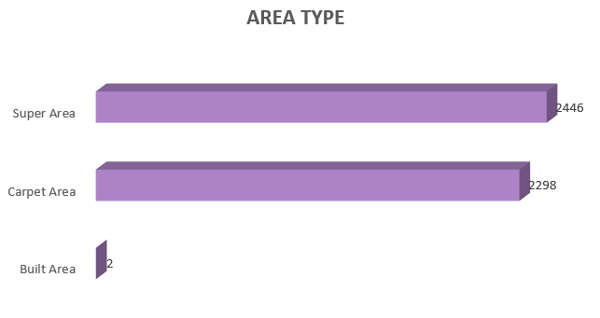
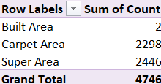
TYPE OF AREA

Slide 17
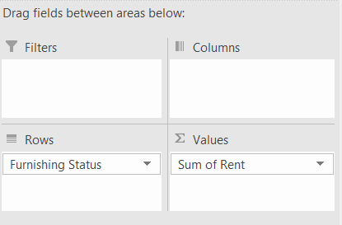
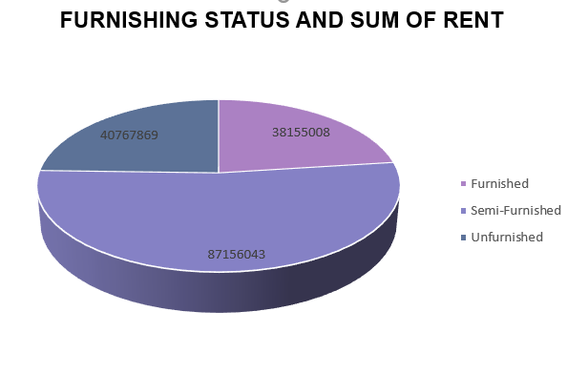
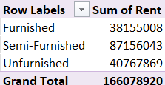
FURNISHING STATUS AND SUM OF RENT

Slide 18
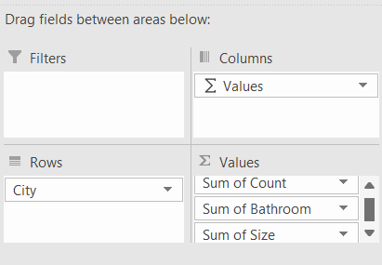
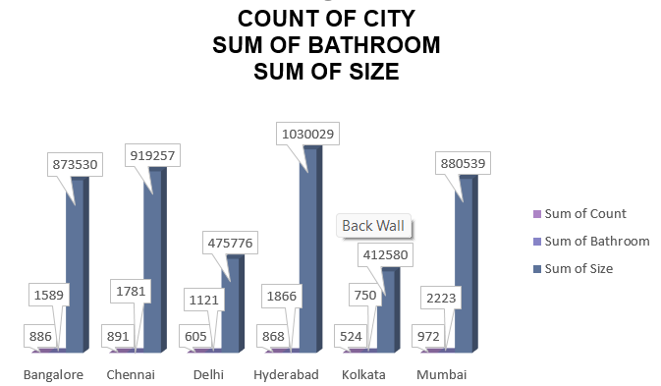
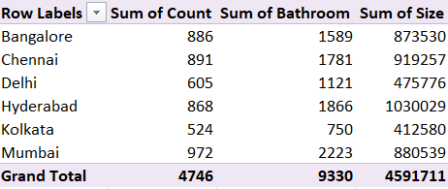
SUM OF SIZE, COUNT OF CITY, SUM OF BATHROOM

Slide 19
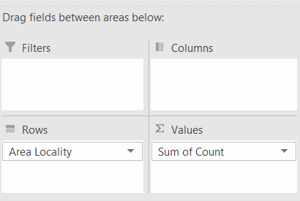
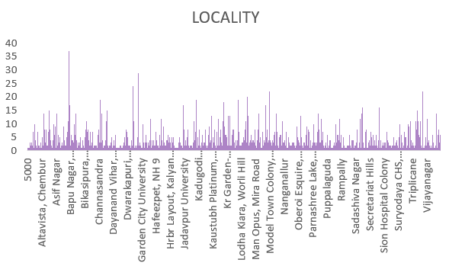
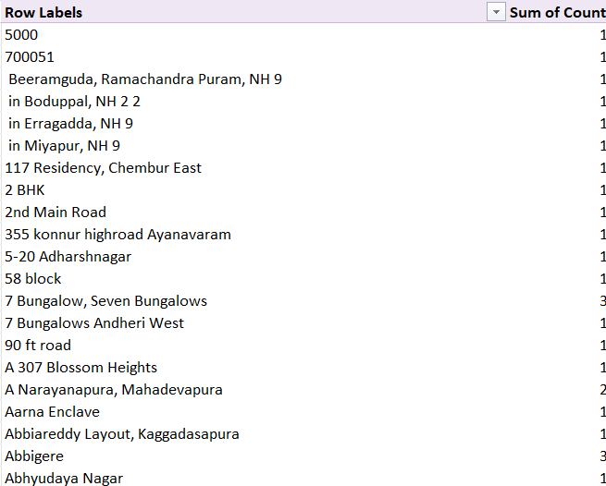
LOCALITY

Slide 20
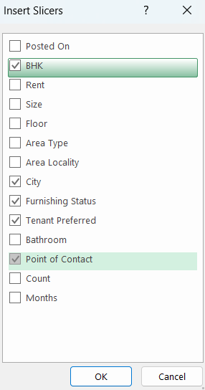
Create slicer
Next, we’ve to create a slicer.
Click On The Pivot Table → Pivot Table Analyze → Insert Slicer
Click City, BHK, Tenant Preferred, Point Of Contact, And Furnishing Status → Ok.

Slide 21
SLICER

Slide 22
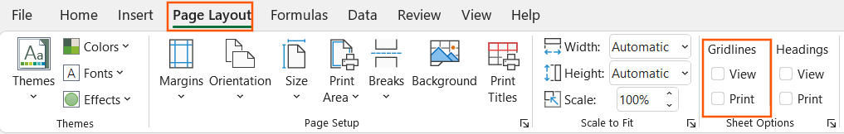
How to create a dashboard
Now, we create a dashboard.
Copy and paste the pivot charts.
Also copy and paste the slicer.
Select Page Layout → Unselect View Option In Gridlines.

Slide 23
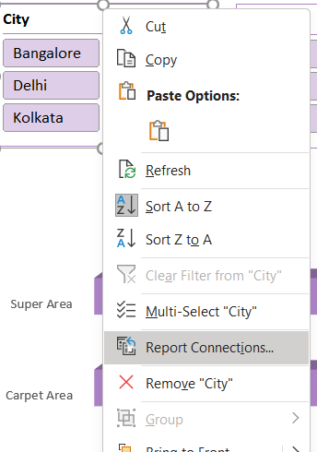
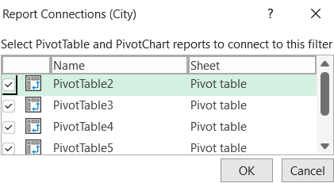
Report connections
Now, Right Click On The Slicer → Report Connections → Select All The Pivot Table → Ok.
Repeat it for all the slicers in the dashboard.

Slide 24
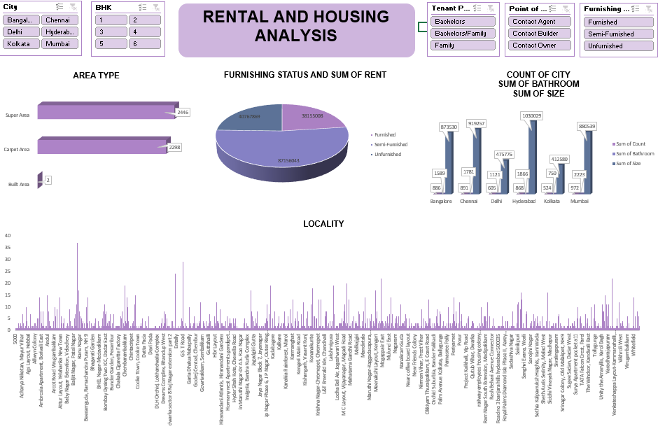
Dashboard

Slide 25
Thank you!

